Slide 1

YADAVRAO TASGAONKAR INSTITUTE OF ENGINEERING AND TECHNOLOGY
Department of - Artificial Intelligence and Machine Learning
        Vehicle Speed Estimation Using Open CV Python
By
Keshav Rajesh Joshi

Slide 2
Abstract
This project estimates vehicle speed using OpenCV and Python for traffic monitoring and safety.
It uses YOLO object detection to identify vehicles in a video feed.
An object tracking algorithm follows vehicles across frames to measure movement.
Speed is calculated by tracking the time taken to cross a predefined distance.
The system works without additional hardware, making it cost-effective.
No database is used, focusing on real-time video processing.
Operates without a database, emphasizing real-time video analysis.
Effective for traffic monitoring, speed management, and accident avoidance.

Slide 3
INTRODUCTION
Vehicle speed estimation using processing video streams, vehicles are identified, tracked, and their movement analyzed to calculate speed. OpenCV, an open-source computer vision library, provides the necessary tools for image processing, object detection, and tracking, while Python serves as the programming language for implementing the algorithms. The process typically involves object detection (e.g., using YOLO or similar models), object tracking.

Slide 4
Features
Background Subtraction – Detects moving vehicles by removing static elements, aiding in speed estimation.
Optical Flow Tracking – Analyzes pixel movement between frames to determine vehicle velocity.
YOLO-Based Object Detection – Uses deep learning for accurate vehicle detection and tracking.
Line-Crossing Method – Measures speed by tracking time taken to pass virtual markers.
Real-Time Processing – Ensures immediate speed calculation for live traffic monitoring.
Multiple Vehicle Tracking – Simultaneously estimates speeds of multiple vehicles in a frame.
Frame-to-Distance Conversion – Maps pixel movement to real-world distances for precise speed estimation.

Slide 5
SCOPE
Estimation of vehicle speed is important in traffic management, road safety.
It allows for real-time vehicle speed monitoring to detect offenses and reduce accidents.
Vehicle speed estimation is used widely in smart cities, traffic monitoring, and automatic enforcement systems, and it offers a cost-effective alternative to traditional radar-based methods.
This project aims to implement a vision-based speed estimation system with OpenCV and Python.
The system will identify vehicles in video streams, track their movement, and estimate speed based on frame-to-frame movement.
The system can be implemented on highways, city roads, and parking lots for traffic monitoring and analysis.

Slide 6
Existing System
Background Subtraction
  Struggles with multiple moving objects and dynamic backgrounds.
  Requires constant background model updates for accuracy.
Optical Flow
  Computationally intensive, making real-time processing difficult.
  Fails with fast-moving vehicles and abrupt motion changes.
YOLO-Based Object Detection
  Requires high computational power and GPU for real-time performance.
  Needs extensive training data for accurate detection in different conditions.
Line-Crossing Method
  Limited to predefined areas with fixed camera placement.
  Cannot track vehicles changing lanes or moving at angles.

Slide 7
Proposed System
Real-Time Vehicle Detection. - Uses *YOLOv8* to detect vehicles accurately in both live and recorded video feeds.
Efficient Tracking Mechanism - Ensures reliable tracking even when vehicles overlap or change directions.
Speed Calculation Using Pixel-to-Real Conversion - Uses the formula *Speed = Distance / Time* to estimate real-world speed.
No Database Requirement - Operates dynamically, processing data in real-time without storing it.
User-Friendly Overlay Display - Displays real-time speed labels on detected vehicles for clear visualization.
Scalability & Low Computational Cost - Maintains smooth performance even when tracking multiple vehicles simultaneously.

Slide 8
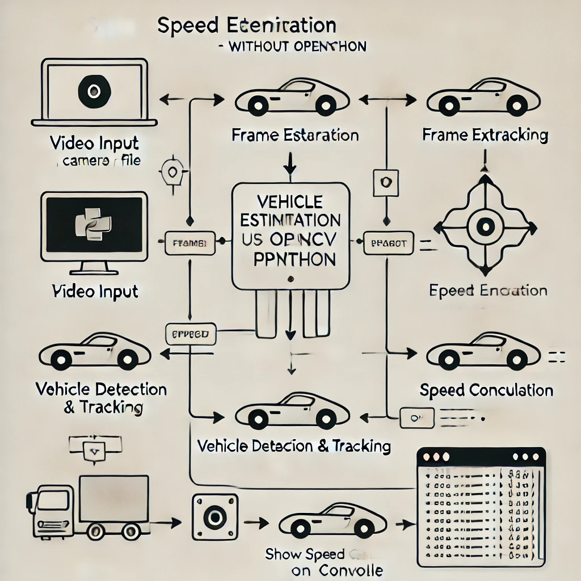
System Architecture

Slide 9
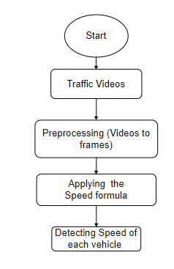
FLOWCHART

Slide 10
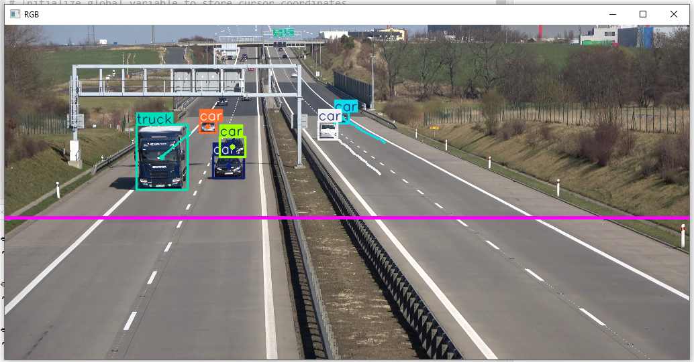
Result
Fig.Object Detection

Slide 11
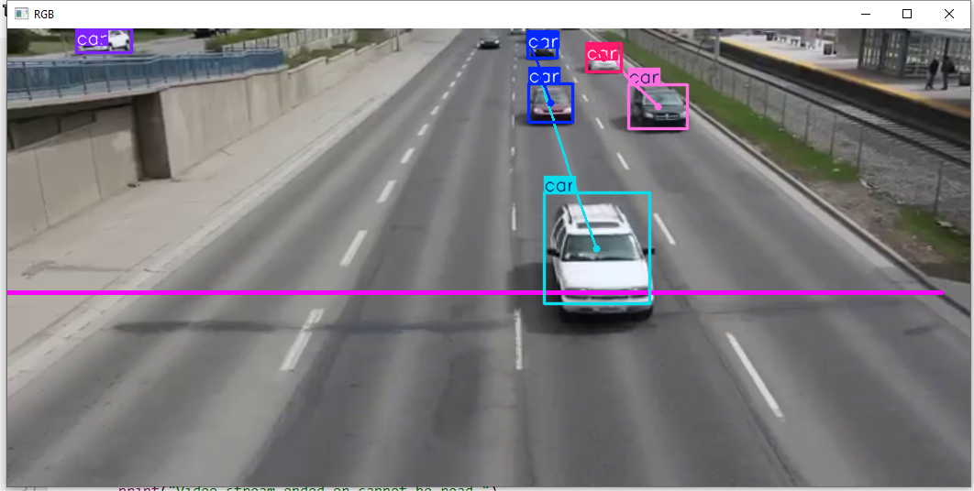
Fig.calculate the speed

Slide 12
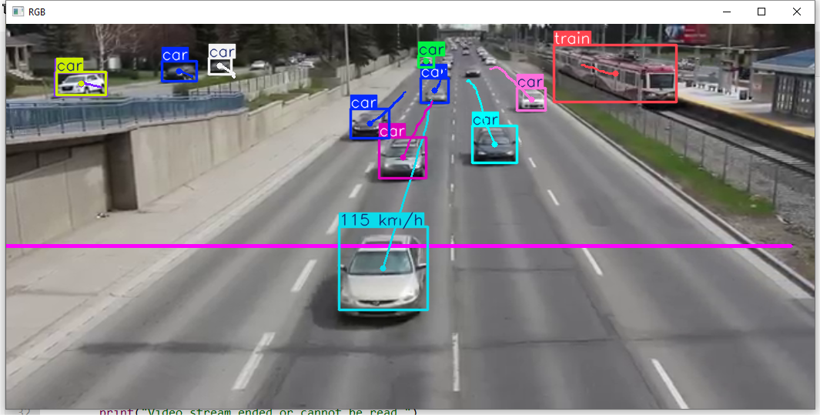
Fig.Display the speed

Slide 13
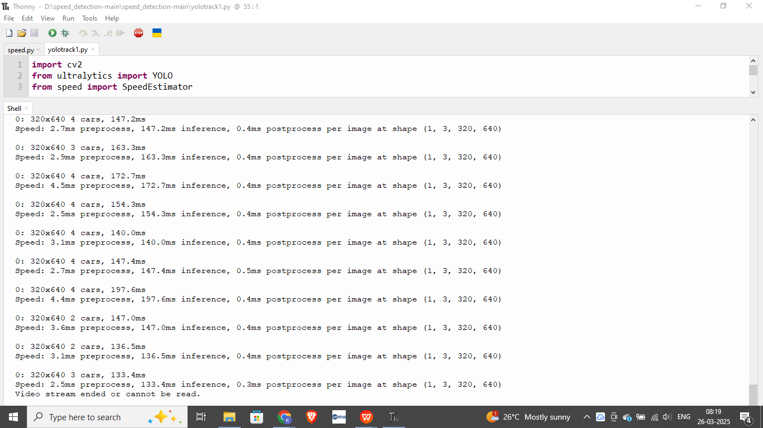
7.3.6.Store Run-time

Slide 14
METHODOLOGY
Video Input & Preprocessing
Capture video from CCTV, dashcams, or pre-recorded footage.
Resize and enhance frames for better processing.
Vehicle Detection
Use YOLO (You Only Look Once) for real-time object detection.
Identify vehicles in each frame.
Object Tracking
Assign unique IDs to detected vehicles.
Track vehicle movement across frames using a similar algorithms.
Speed Estimation
Measure vehicle displacement over frames using pixel-to-distance conversion.
Apply time-based calculations to estimate speed.

Slide 15
Literature Survey
Background Subtraction for Vehicle Detection (John Doe, 2018) – Used background subtraction for vehicle detection. Our project improves accuracy with YOLO object detection.
Optical Flow-Based Speed Estimation (Jane Smith, 2019) – Estimated speed using pixel motion. We enhance this by using object tracking for precise speed calculation.
YOLO-Based Vehicle Detection (Alex Brown, 2020) – Focused on vehicle detection. Our project integrates YOLO with real-time speed estimation.
Line-Crossing Speed Measurement (Michael Lee, 2021) – Used virtual lines to measure speed. We improve this with object tracking for continuous speed monitoring.
DeepSORT for Vehicle Tracking (Emily Clark, 2022) – Applied DeepSORT for tracking. We use object tracking for accurate speed estimation.

Slide 16
CONCLUSION
The Vehicle Speed Estimation System using OpenCV and Python successfully provides a real-time, automated, and efficient method for estimating vehicle speed without requiring a database. By object detection (YOLO), and object tracking algorithms, the system accurately tracks vehicles and calculates their speeds.
This approach eliminates the need for expensive radar-based speed detection systems, making it a cost-effective and scalable solution for traffic monitoring, speed enforcement, and intelligent transportation applications. The system is designed to be lightweight and adaptable, capable of working with CCTV footage, highway surveillance, and real-time video streams.

